Slide 1
Python Advanced Concepts
Life Choices Coding Academy 2020

Slide 2
Learning outcome:
By the end of this section, student should be able to:
Know how to recognize when a stack is a good choice for data structures
Decide which implementation is best for your program

Slide 3
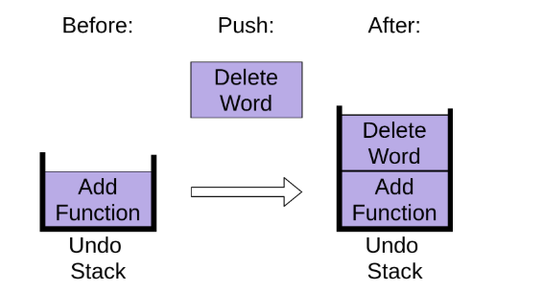
What Is a Stack?
A data structure that stores items in a Last-In/First-Out manner(LIFO)
To ensure that the application works as expected.
Notes:
This is frequently referred to as LIFO. This is in contrast to a queue, which stores items in a First-In/First-Out(FIFO) manner.
Let’s imagine you’re editing a Python file so we can look at some of the operations you perform. First, you add a new function. This adds a new item to the undo stack:

Slide 4
What can you use to implement a Stack in Python?
You can use the following data structures:
list
collection.deque
queue.LifoQueue
Notes:
There are couple of options when you’re implementing a Python stack. This section won’t cover all of them, just the basic ones that will meet almost all of your needs. You’ll focus on using data structures that are part of the Python library, rather than writing your own or using third-party packages.
You’ll look at the following Python stack implementation:
list
collections.deque
queue.LifeQueue

Slide 5
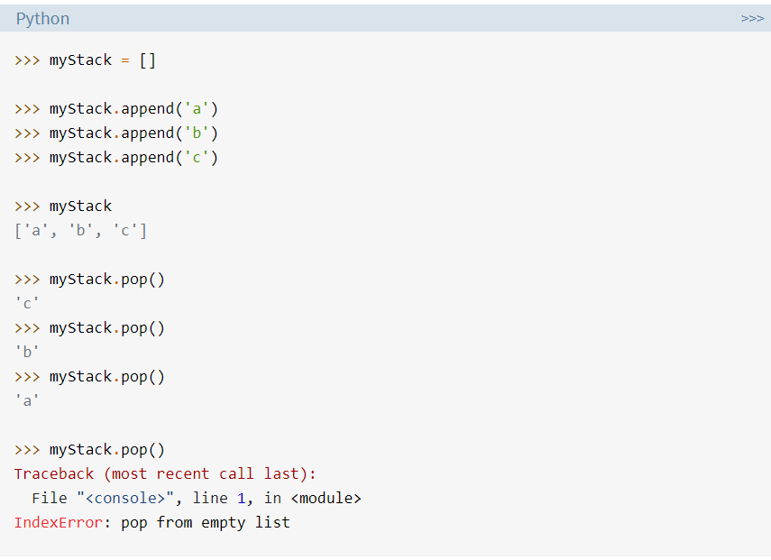
Using list to Create a Python Stack
Notes:
The built-in list structure that you likely use frequently in your programs can be used as a stack. Instead of .push(), you can use .append() to add new elements to the top of your stack, while .pop() removes the elements in the LIFO order.
You can see in the final command that a list will raise an IndexError if you call .pop() on an empty stack

Slide 6
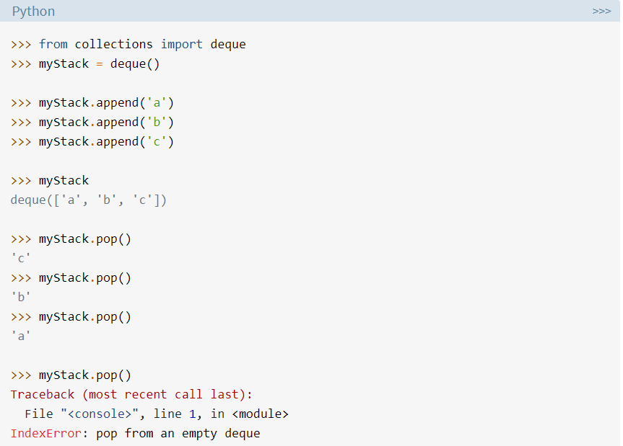
Using collections.deque in Python
Notes:
The collections module contains deque, which is useful for creating Python stacks. Deque is pronounced “deck” and stands for “double-ended queue.”
You can use the same methods on deque as you saw above for list, .append(), and .pop():
This looks almost identical to the list example above. At this point, you might be wondering why the Python core developers would create two data structures that look the same.

Slide 7
Why choose deque over list?
Deques have O(1) speed for appendleft() and popleft().
List have O(n) performance for insert(0, value) and pop(0)
List append performance is hit and miss because it uses realloc() under the hood.

Slide 8
Operations on deque
append() - This function is used to insert the value in the deque.
appendleft() - insert the value to the left end of deque.
pop() - used to delete an element from the right end of deque
popleft() - used to delete an argument from the left end of deque.
Notes:
We will explore other functions later on.

